Slide 1
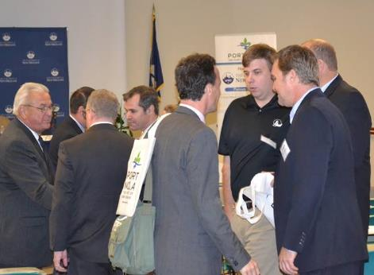
Port of New Orleans
Maritime Workforce Summit
Special Events
Use this area for logo
(delete text box before placing logo)

